Slide 1
Proposed FY 2019-2023
Capital Improvement Program (CIP)
December 3, 2018
Market Octavia Community Advisory Committee

Slide 2
The Capital Improvement Program is:
A fiscally constrained, 5-year program of capital projects
An implementation plan for regional, citywide, and agency-wide strategies and policy goals:
SFMTA Strategic Plan
SFMTA 20-Year Capital Plan
Vision Zero
Muni Forward
Fleet Plan
Building Progress Program
Bicycle and Pedestrian Strategies
Plan Bay Area
SF General Plan
Neighborhood & Area Plans
SFCTA Transportation Plan
FY 2019-2023 Capital Improvement Program
2019
2020
2021
2022
2023
{
Capital Budget

Slide 3
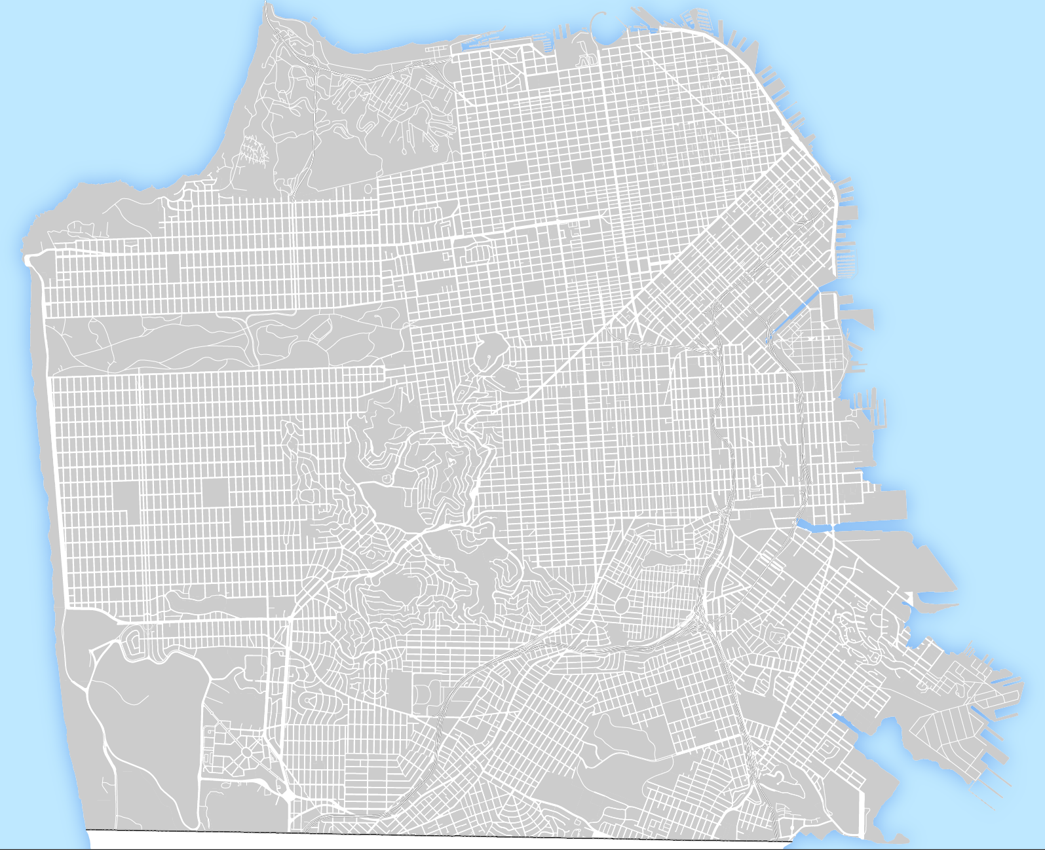
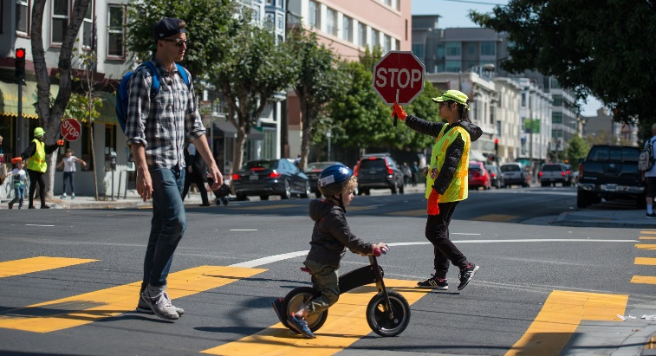




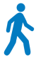
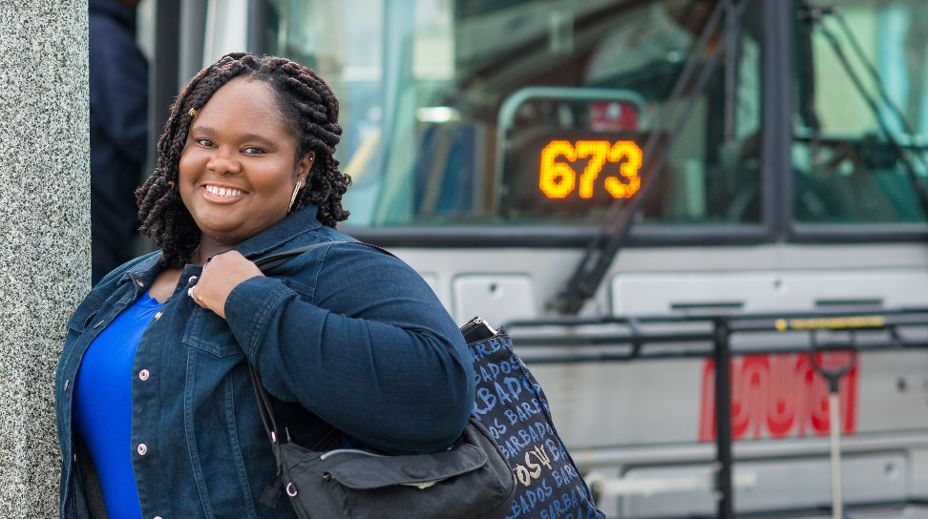
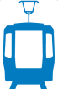

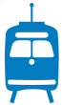
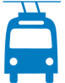

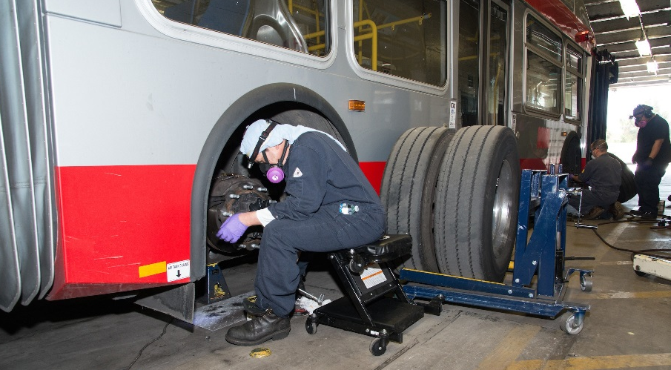
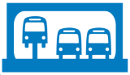
CIP Policy Goals
Vision Zero
Transit First
State of
Good Repair

Slide 4
FY19-23 CIP (by color of money)
$3.0B from over 40 different fund sources
Federal
Federal Transit Administration Formula Funds
Core Capacity Challenge Grant Program
Local & Regional
Proposition K Sales Tax
General Obligation Bond
Developer Impact Fees
Bridge Tolls, incl. Regional Measure 3
State
Cap and Trade
Active Transportation Program (ATP)
Competitive Grants

Slide 5
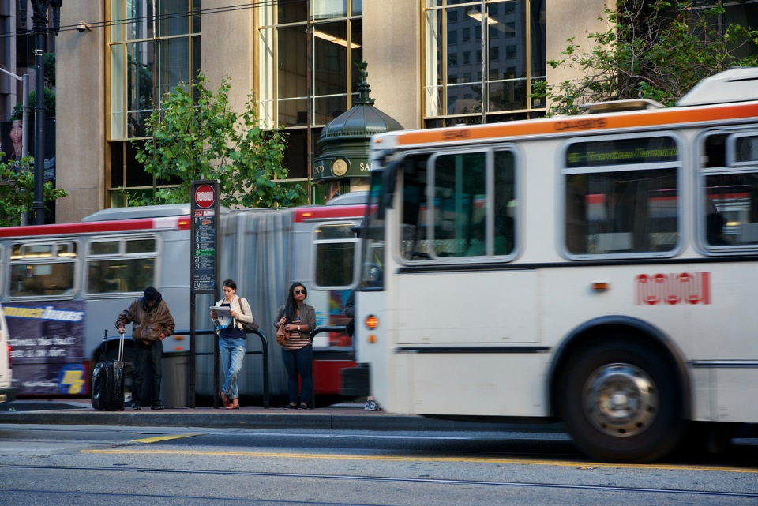
KEY CITYWIDE CAPITAL PROJECTS
Central Subway
Twin Peaks Rail Replacement Project
State of Good Repair for Track, Overhead, Signals and Traction Power
Initiates a major upgrade of the subway ATCS
Castro Station Elevator
Potrero Facility Reconstruction
Muni Metro East Expansion
Fleet replacement and expansion (Motor Coach, Trolley Coach, LRV, Paratransit)
Vehicle Overhauls
Cable Car Renovation
22 Fillmore Transit Priority
Muni Forward OCS Spot Improvements
T-Third Warriors Arena Platform
28 19th Avenue Rapid
L Taraval: Transit & Streetscape Enhancements
Gough Corridor Signal Upgrade

Slide 6
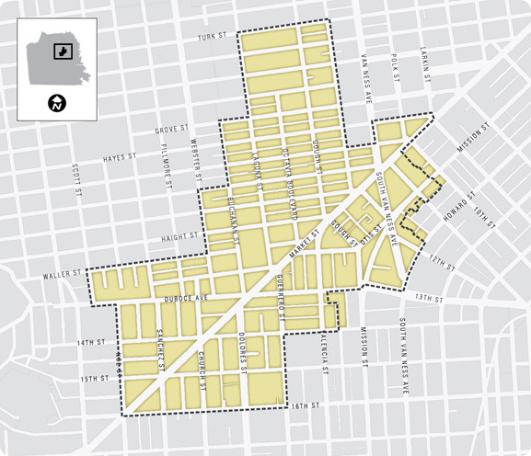
Market Octavia Neighborhood

Slide 7
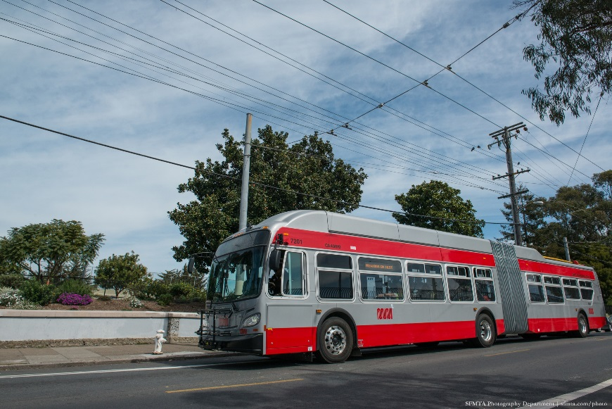
Capital Projects in Market Octavia
Transit Optimization
22 Fillmore - 16th Street Transit Priority
Better Market Street
Van Ness BRT
Light Rail Service Enhancements
Dolores and Market Intersection Enhancements
Muni Metro Station Enhancements
OCS Stop Improvements
Local Bus Transit Signal Priority Intersection Deployment
  Projects in BOLD are IPIC funded

Slide 8
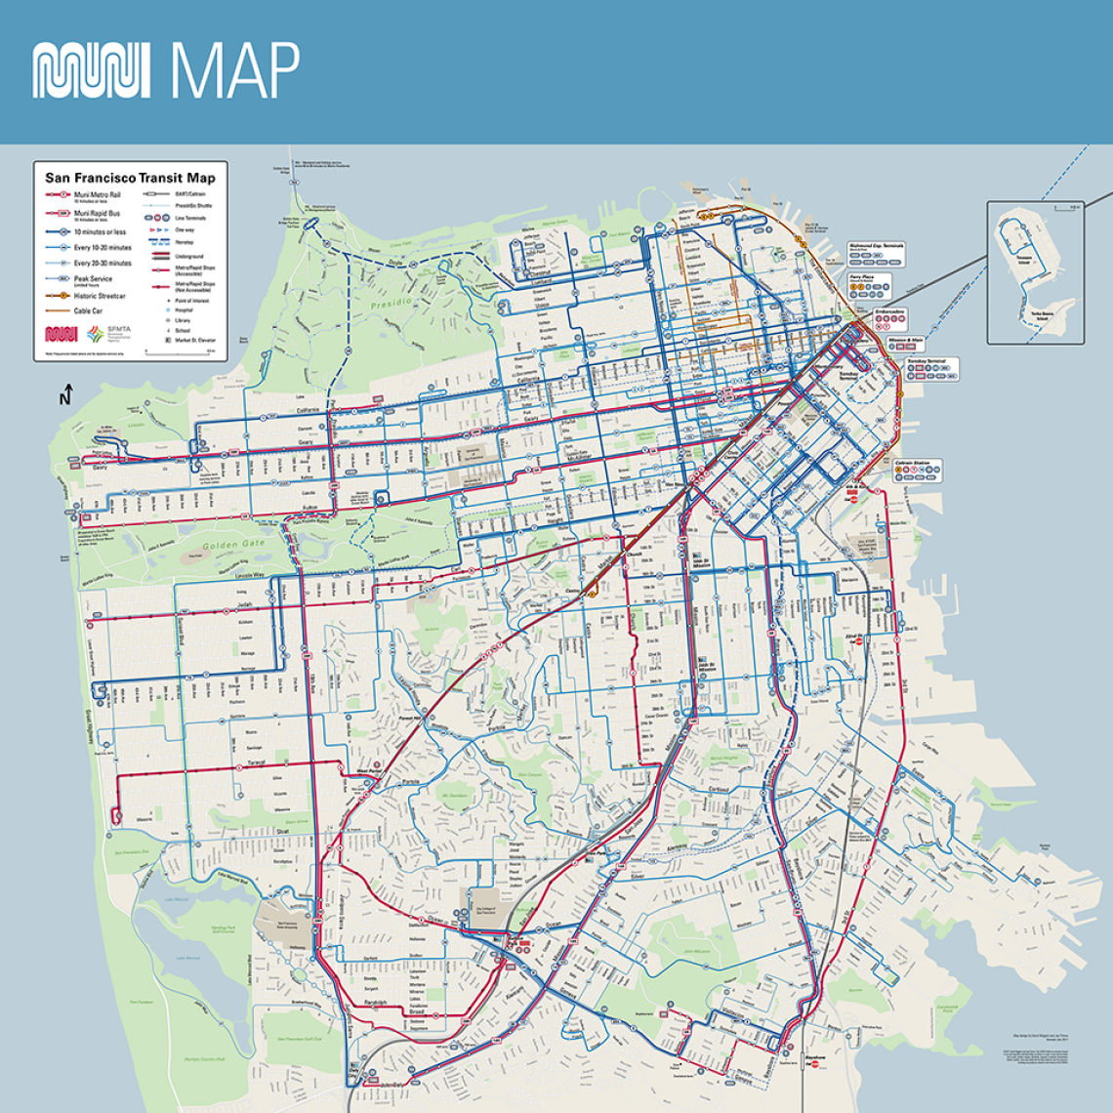
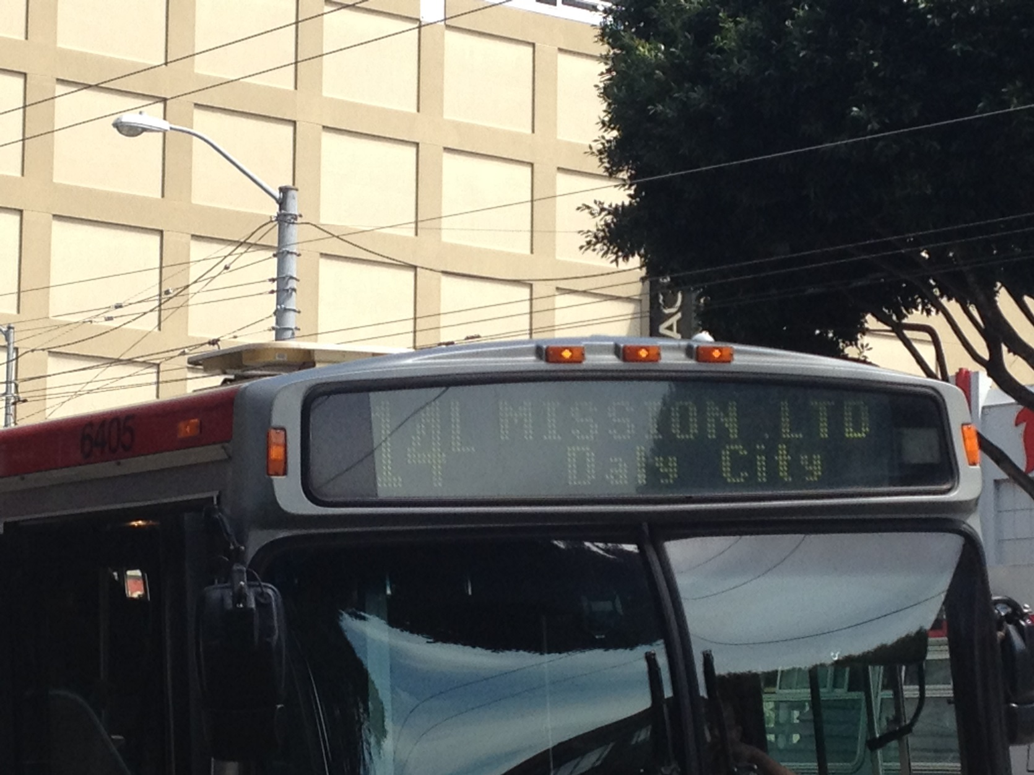
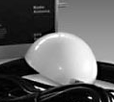
Bus Transit Signal Priority
1200+ signals
(~1000 serve Muni)
700k rides per day
Transit First policy

Slide 9
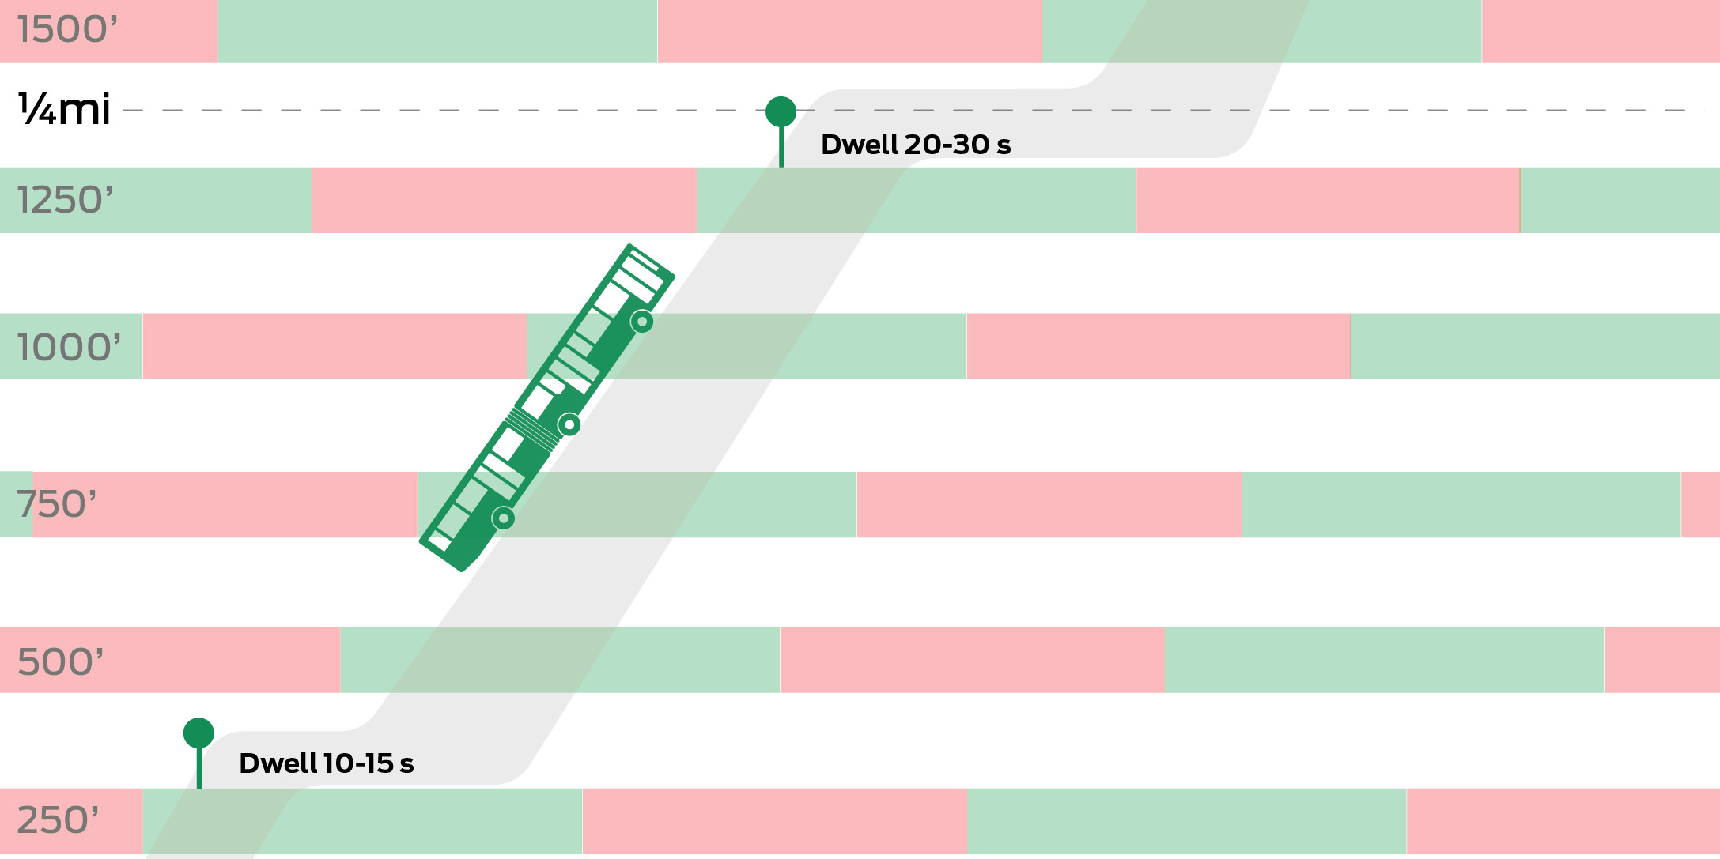
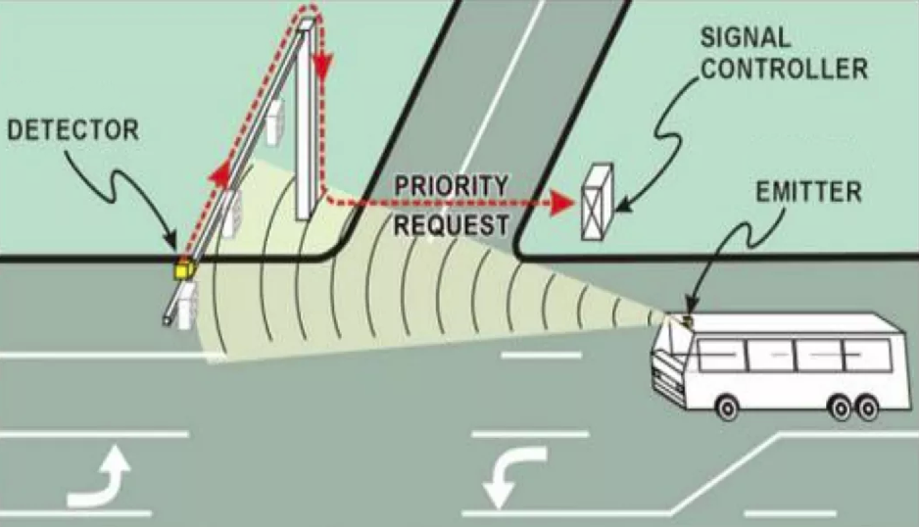
Transit Signal Priority
Passive priority
  Utilize signal progression
  No additional hardware required
Active priority
  Green extension
  Early green
Conditional priority
  Schedule based (on time vs late)
  Direction and time of day
  Conflicting routes
Passive TSP
Active TSP

Slide 10
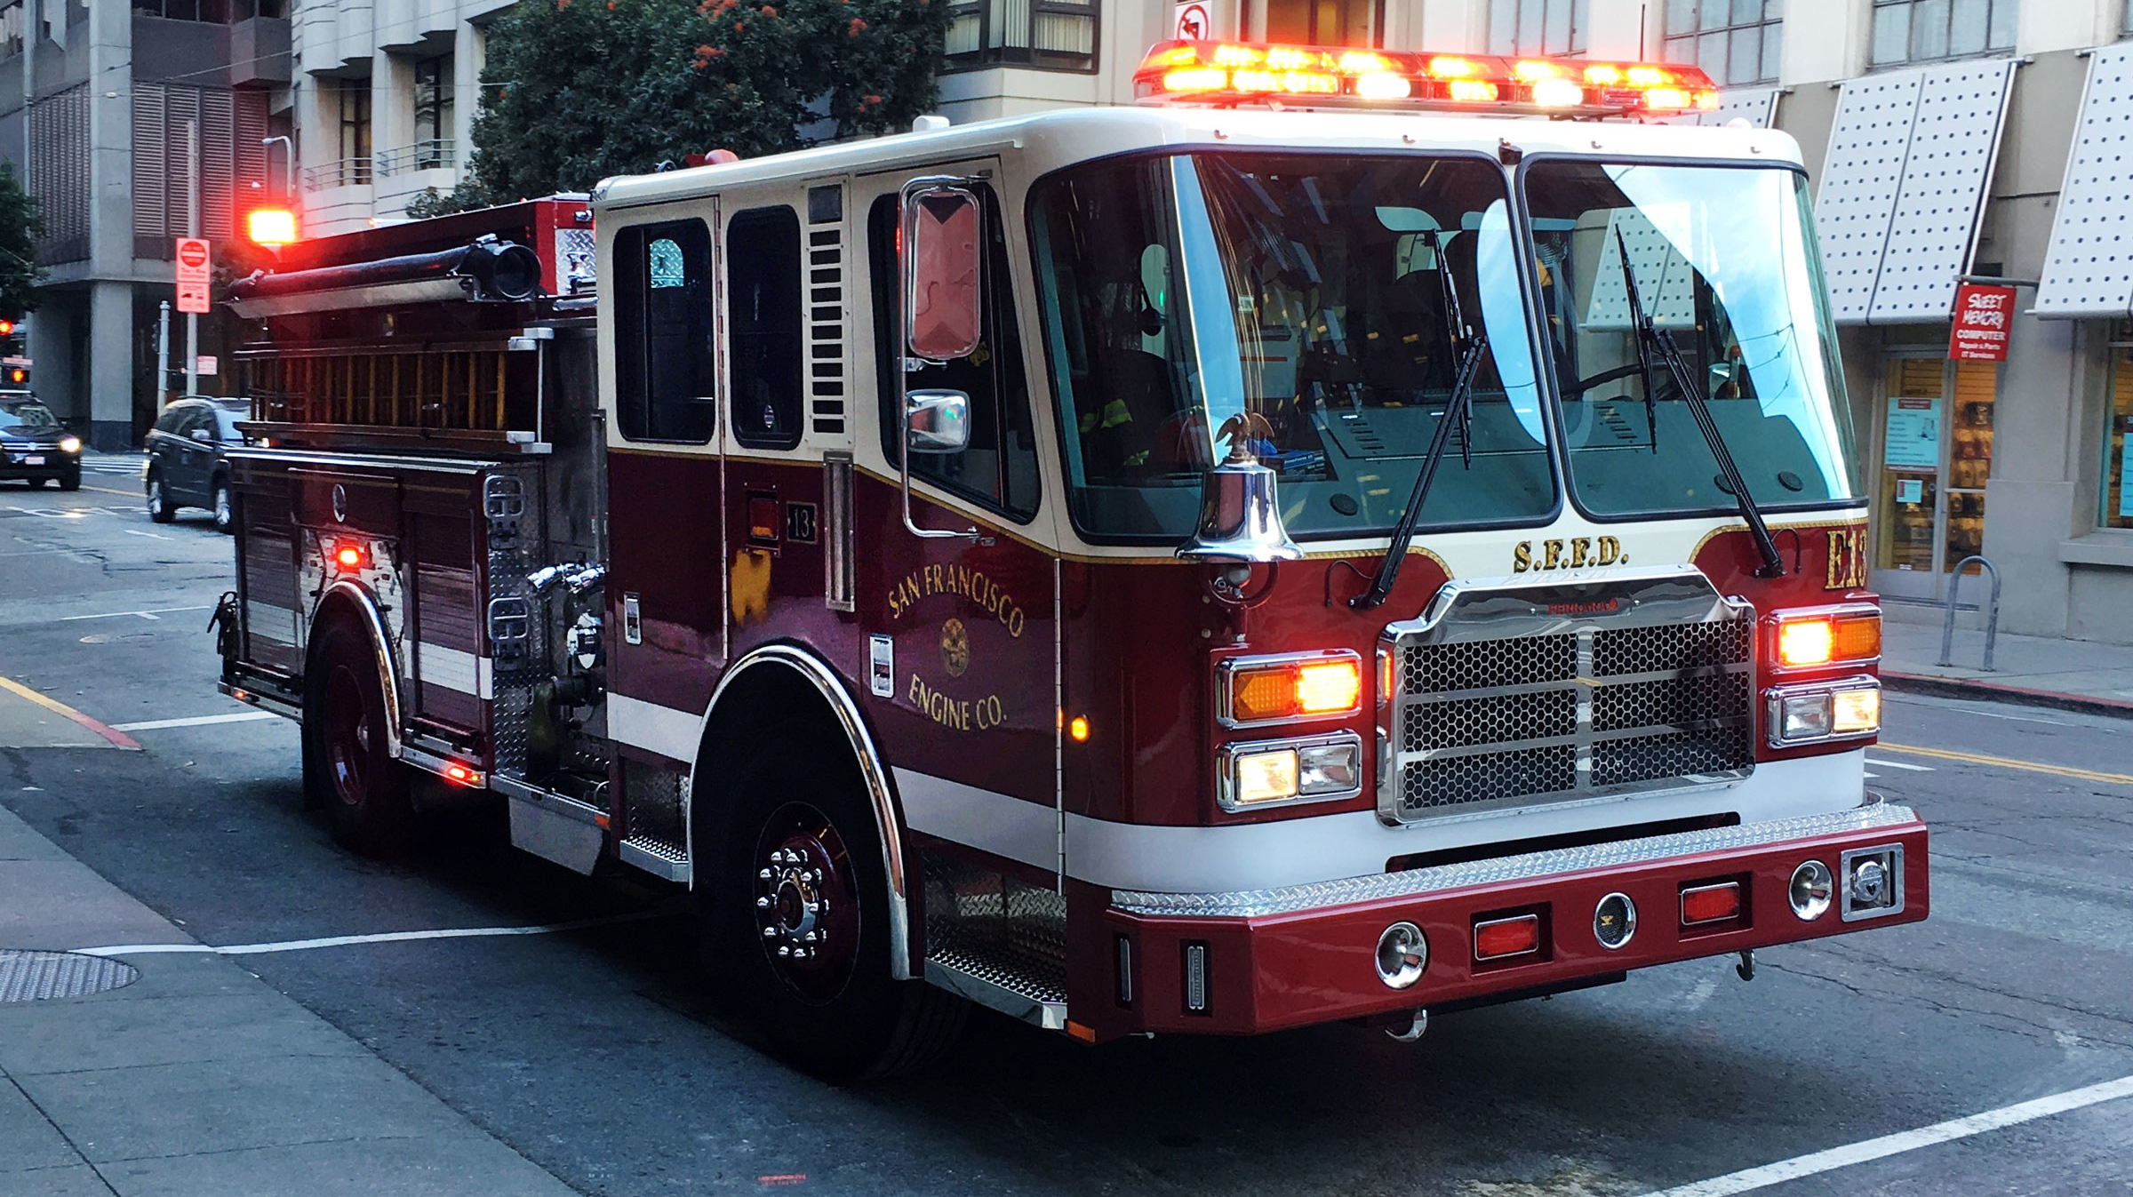
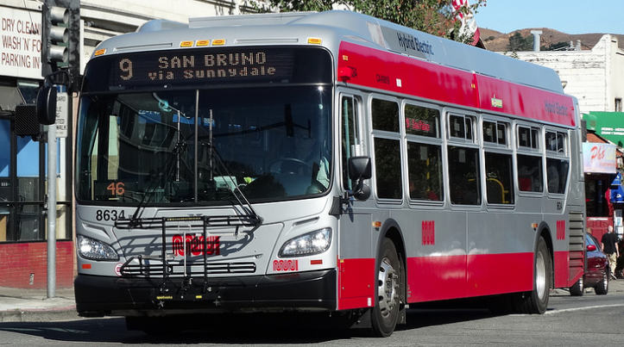
TSP vs Preemption
Preemption
Always granted
Will hold green for an unlimited time
Will skip phases
TSP
Requests, but isn’t always granted
Limited extensions/early
Won’t skip phases

Slide 11
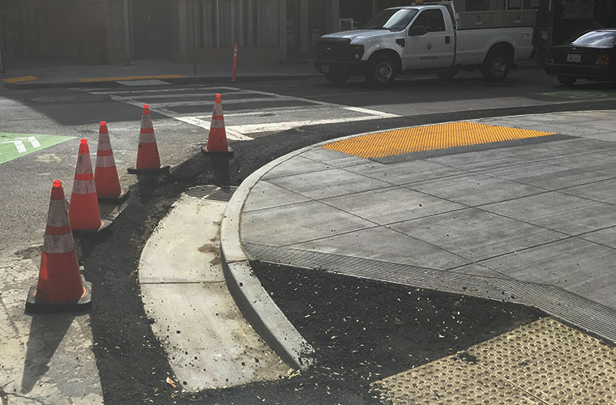
Capital Projects in Market Octavia
Complete Streets
  13th Street Protected Bike Lanes*
  Move Western Addition Mid- Term Improvements*
  Octavia Boulevard Enhancement Project
  Otis Street Improvement*
  Page Street Neighborway (Market to Webster)
  Upper Market Street Safety Project
  Valencia Street Bikeway Improvements*
Signals
  Haight/Steiner as part of Contract 35 Traffic Signal Upgrades
  Gough Street Signal Upgrade project
  Western Addition Traffic Signal Upgrade project
  Projects in BOLD are IPIC funded

Slide 12
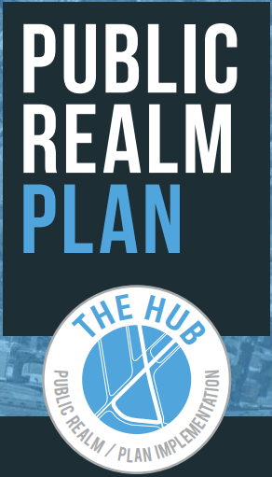
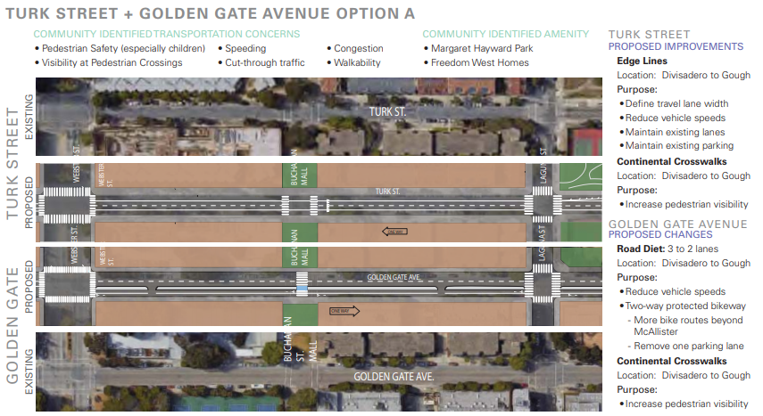
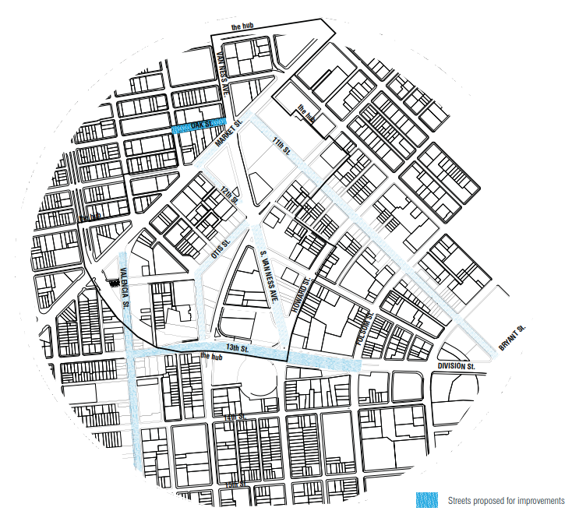
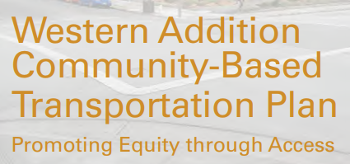
*New Complete Streets Projects
Notes:
13th Street Protected Bike Lanes*
$3.9M total, including $175k of IPIC and potentially more in FY22 or later
Planning start summer 2020
Con start FY23
Otis Street Improvement*
$500k to start planning; $7M for other phases unfunded
Planning start spring 2020
Construction start after FY23
Valencia Bikeway Improvements
$14.7M total for full corridor, includes $4.7M in IPIC now for implementation (near term, long term, and curb management)
Construction start fall 2021
Move Western Addition Mid- Term Improvements*
$725k in IPIC funds
Summer 2019

Slide 13
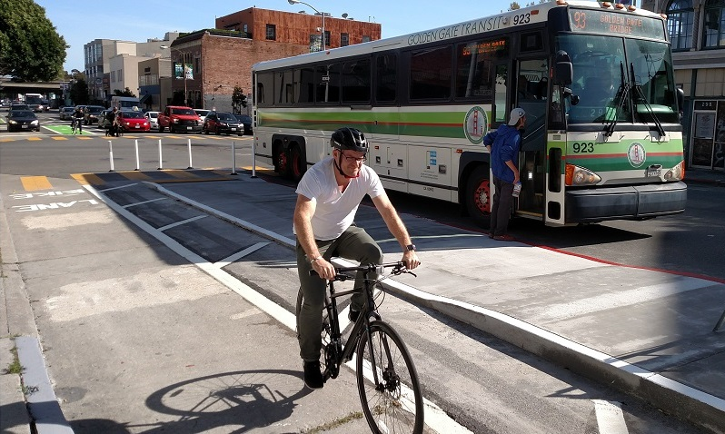
Streets CIP - Corridor/Area Projects
Ongoing Projects
Folsom-Howard Streetscape Project
6th Street Streetscape Project
Taylor Street Streetscape Project
Mission Street Excelsior Safety Project
Powell Street Plaza
Embarcadero Enhancement Project
Monterrey Boulevard Safety Project
Sloat/Skyline Intersection Improvements
Hairball Improvements
Alemany Interchange Improvements
New Projects
Ocean Avenue Safety Improvements
Bayview Community Based Transportation Plan
Valencia Street Bikeway Improvement
Hyde Street Safety Project
Schools Engineering Program
Beale Street/Transbay Bicycle Connection
Battery/Sansome Bike Project

Slide 14
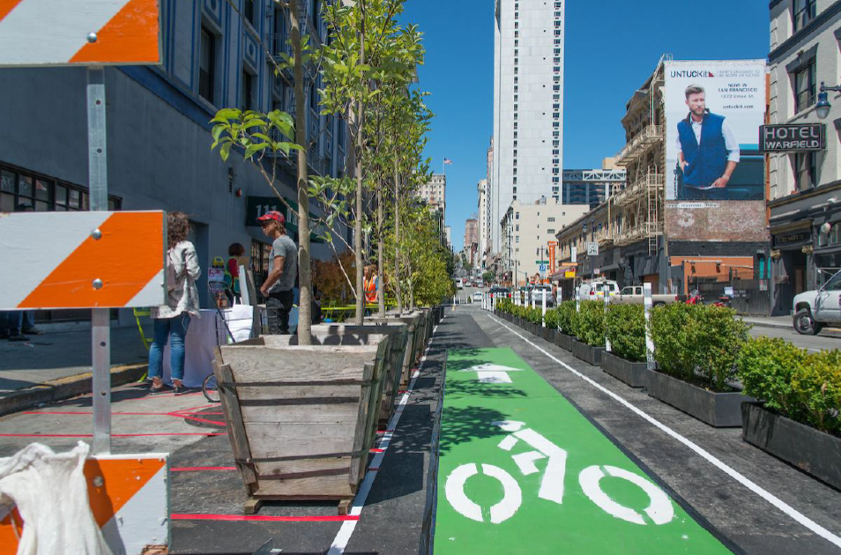
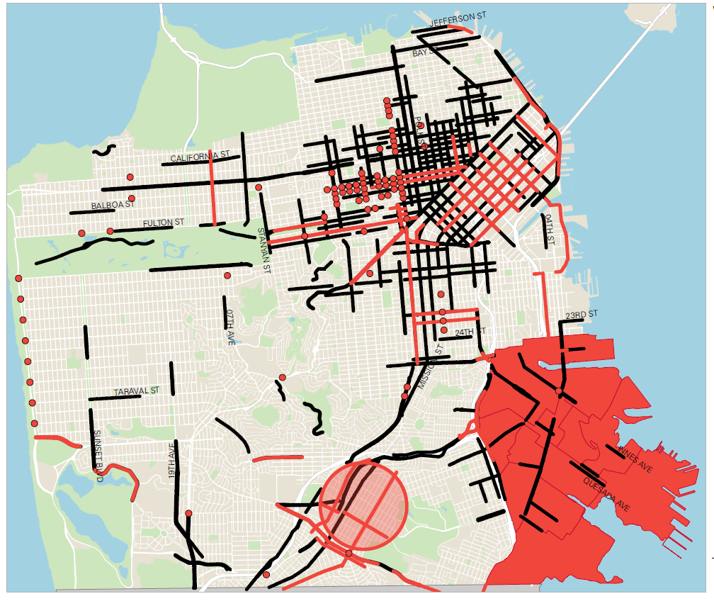
Streets CIP - Guiding Principles & Project Development
Supports 2017 VZ High Injury Network
Implements previous or ongoing planning effort/strategy recommendation
Balances limited number of corridor/areawide projects with programs
Implements near term improvements of larger corridor projects
Notes:
New CIP projects are either located on 2017 Vision Zero High Injury Network or have been identified through a previous or ongoing planning effort
Streets program includes an emphasis on Vision Zero over mode shift
Projects will incorporate near-term measures when possible
Constrained number of corridor projects to emphasize and ensure appropriate level of community engagement and overall project quality
Use of programs allows flexibility and responsiveness (i.e., Construction Coordination, WalkFirst Quick & Effective, Vision Zero Bikeway Improvements)
20-30% of allocated funds in Streets CIP are for ‘sideways’ projects
Emphasis on customer service and responsiveness (e.g., funding levels for outreach,Traffic Calming Spot Improvements)
Offset operating budget costs when possible (i.e., program and fund bike share program, pavement to parks, state of good repair for bike and pedestrian facilities)
Community Response Team Implementation
Achieve at least 13 miles of safety improvements on the High Injury Network annually
Implement quick and effective near-term measures to address safety
Increase public support for projects with improved community engagement
Create flexible funding programs so that we can be more responsive to arising needs
Vision Zero Bikeway Upgrades
Bike Spot Improvements
Bike Traffic Signals
State of Good Repair
WalkFirst Quick and Effective
Expanded application-based traffic calming program
Programs focused on children, seniors, and PWD
Speed Humps on 15mph streets
Neighborways

Slide 15
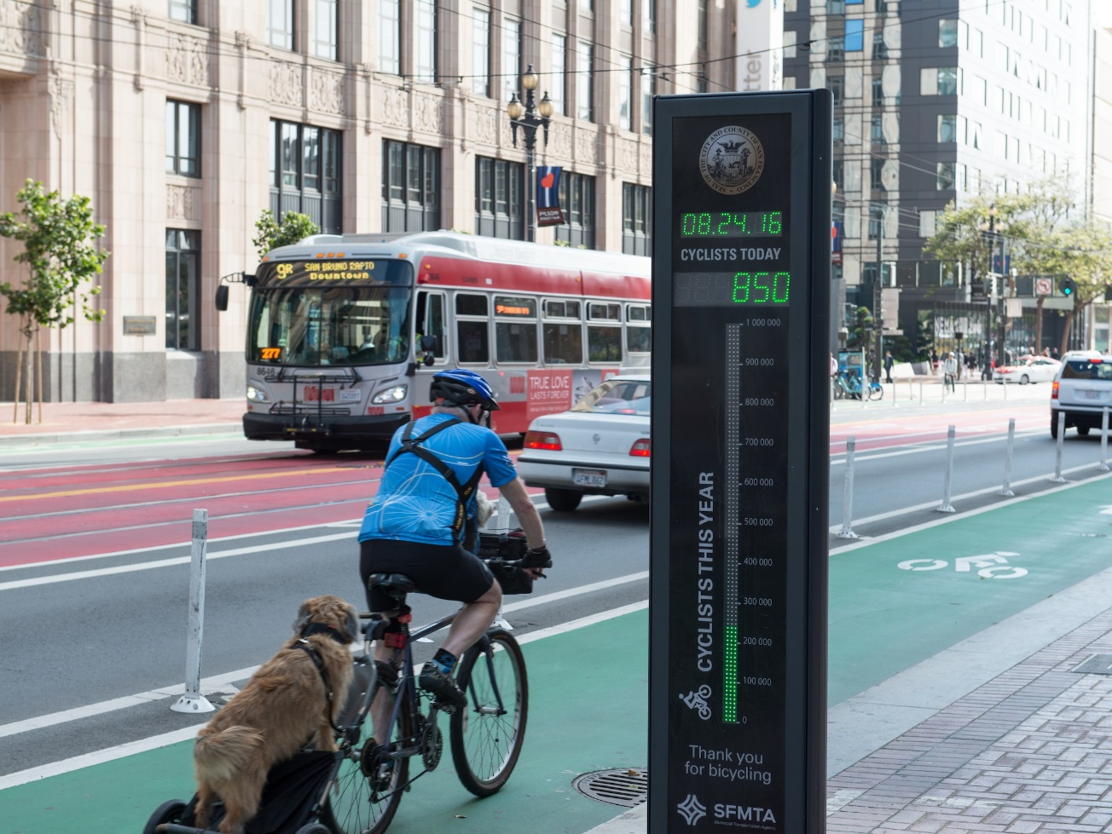
Thank You
Thank You

Slide 16
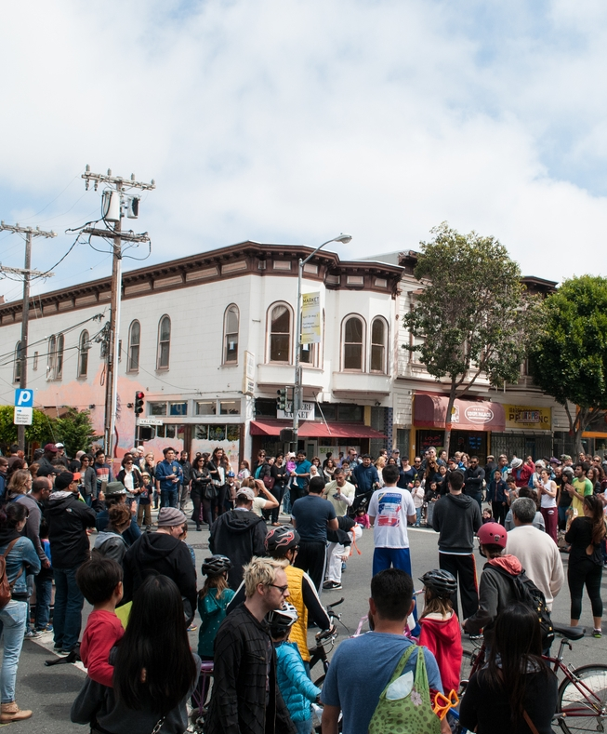
Project Prioritization
Consistency with existing agency goals
  Vision Zero
  Transit First
  State of Good Repair
  Safety
Investing in projects with strong community support
Focus on communities of concern

